Slide 1
Initial Analysis Results
Team:
Lodging Leaders
March 2, 2023
Notes:
David opens it up for us.

Slide 2

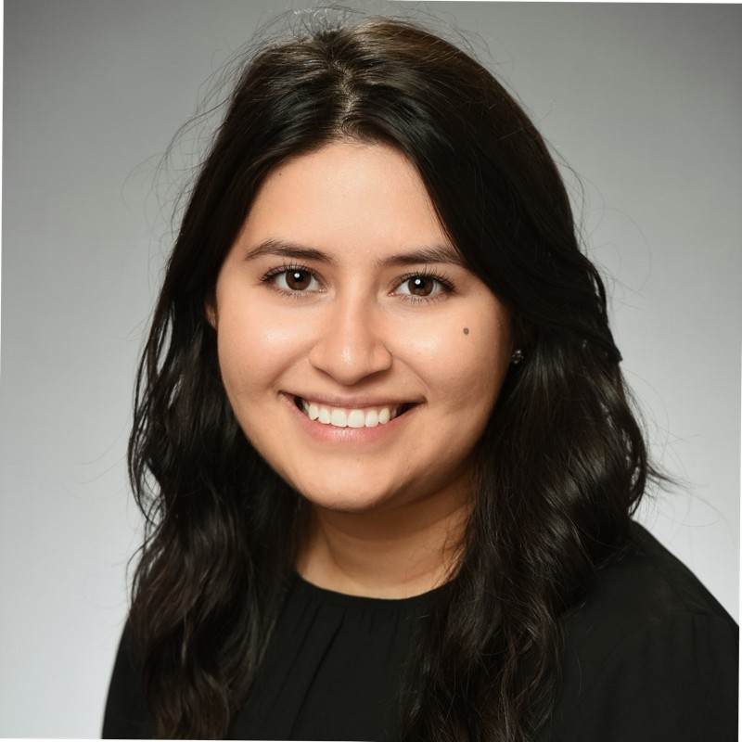


Team Introduction
David Askew
Maria Casas
MS in Applied Statistics and Analytics
Graduating May 2023
Nathaniel Jones
MSIS
Cooking, painting and home improvement projects
MS in Applied Statistics and Analytics
Graduating December 2023
Puzzles, Movies, and Data Science
Graduating June 2023
Hiking, Boating, and Traveling.
McKaleb Harlemon
MS in Applied Statistics and Analytics
Graduating May 2024
Sports Psychology
Notes:
Everyone will introduce themselves as before.
NO MORE THAN 1 MINUTE TOTAL FOR THIS SLIDE.

Slide 3
Analytical Plan Review

Slide 4
Problem Overview
General Problem
To accurately predict whether a member will click on a link in an email
Why It Matters
IHG can be better equipped to understand who is more likely to click links in their emails
Our analysis can generate a better understanding of rewards member base that will allow IHG to better select optimal audiences for email campaigns
Notes:
MK-1.5 Minutes
As a review of the objective of this project, we are working to predict whether a rewards member will click on an email link.
The fact that this is predictive question guides our approach in attempting to answer it.
We believe that by answering this question we can help IHG understand who is more likely to click and they will be better equipped to select the best audiences for their email campaigns.

Slide 5
Approach
Primary Goals
Build out time frame for training dataset and stay/email history
Engineer feature variables for input datasets
Assess quality and usefulness of variables
End Goals​
Build classification models for prediction​
Create interactive dashboard​
Notes:
DA-1.5 Minutes
The models we are focusing on building will be a decision tree model [CLICK] and a naïve bayes model. [CLICK]
Building these models will allow us to compare the different algorithmic approaches on the data. [CLICK]
In addition to that the decision tree model requires very littler data preparation and [CLICK] is not effected by missing or extreme values.
This model also handles our [CLICK] class imbalance issue, but could be very slow to train depending on the number of rows and columns used. [CLICK]
On the other hand, the naïve bayes model is fast and can provide real-time predictions. [CLICK]
This model also works really well with a high number of categorical columns, like the data we have. [CLICK]
It can also outperform a decision tree model and be used to generatively produce likelihoods. [CLICK]
Mention performance metrics that we will use

Slide 6
Data Preprocessing &
Feature Engineering

Slide 7
Approach for Feature Engineering
Goal: Engineer variables that maximize the performance in predicting clicks
Stay History
When was the last stay?
Average stay length?
Total revenue?
Email History
When was the last click?
Total emails received?
Click rate?
Member Details
Program tenure?
Member tier?
Income group?
Notes:
DA-1.5

Slide 8
Feature Engineering
Member Variables
Email History Variables
Stay History Variables
Enrollment in Reward Program
Enrollment channel
Rewards program tenure
Member tier
Member lifecycle
Member/Email Interaction
Total emails sent
Days since last email
Days since last click
Total clicks
Click rate
Unsubscribe indicator
Stay History
Total stays
Total rooms booked
Total nights stayed
Days since last stay
Average nights per stay
Demographics
Age group
Gender
Income group
Member subregion
Email Campaign Details
Campaign type of email sent
Distinct number of campaign types received
Click rate by campaign type
Stay Tendencies
Proportion of stays by business/leisure
Proportion on stays paid by hotel chain cat.
Average guests per stay
Avg days between confirmation and check-in
Seasonal Variables based on Send Date
Days since last holiday
Days until next holiday
Seasonal indicator
Day of the week
Day of the month
Revenue and Rewards
Average revenue per stay
Total revenue
Days since last points/rewards stay
Proportion on stays paid by points/rewards
Notes:
DA-1.5-
Mention Reward Program Tenure as we had to develop that. >additionally-> tenure is important because a recent member might be on the look out for emails to get an idea of what the rewards program offers; Demographics: mention income group and how we left out income code because IHG told us to Member/email interaction: mention Click Rate and how although it may seem obvious, we want to predict a click by using historical tendency to click as a predictor; Email campaign details: distinct number of campaign types received – point to drive here is that by know how many types of campaigns get send to a particular member, we can get an idea of the variety of campaigns they are targeted with Seasonal variables: Not just the stay and email interaction can explain a click – we want to include variables related to when the member gets an email because proximity to a travel holiday or day of the month they get the email could help us predict. Stay history: Something like the recency of a stay or whether or not they stayed, we hope can help predict. Stay tendencies: the hotel chain a member frequents can educate us in what emails they are more likely to click. Revenue and rewards: a member’s engagement with the rewards program by looking at the frequency of stays paid for by points and rewards could show a member that might be eager to receive more promotions and therefore click

Slide 9
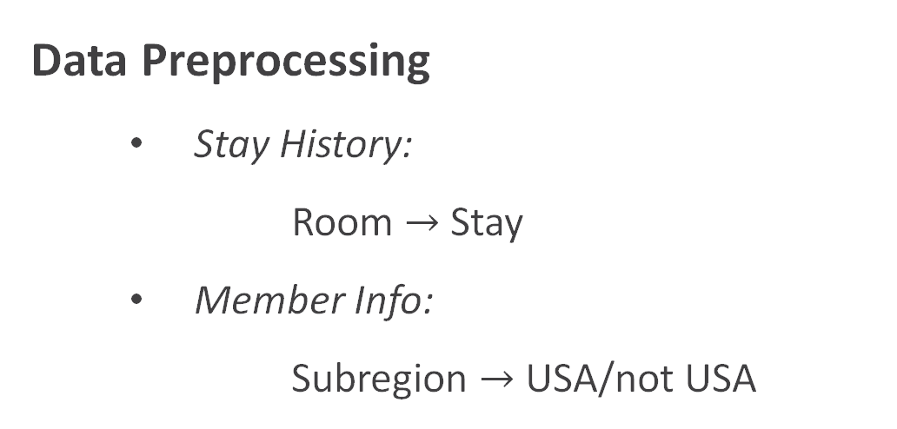
What Have We Built
Data Preprocessing
Stay History:
Room $→$ Stay
Member Info:
Subregion $→$ USA/not USA
Partitioned Data
1 month (7.2 million emails)
90 Days History
44 Features (31 New)

Slide 10
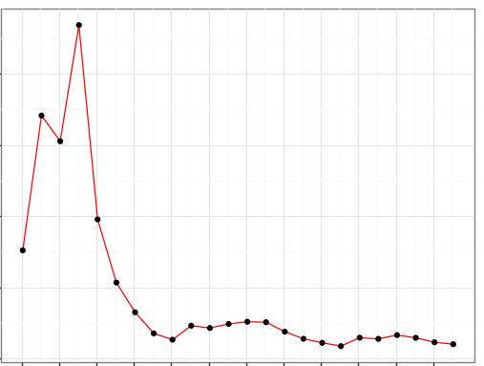
Hypotheses
Percent of Clicks by Months of Data in Focus
Prior email and stay history can model CLICK behavior over a 1-month period
Collecting 90 days of a member’s history is sufficient in capturing that relationship
2.0%
1.8%
1.5%
1.3%
1.0%
0
1
2
3
4
5
6
7
8
9
10
11
Months of Data in Focus
Notes:
As we move forward to building our model, there are two hypotheses that will be tested and refined before the final presentation.
The first hypothesis is ‘Prior email and stay history can model CLICK behavior over a 1-month period.’
This is important [CLICK] because the percent of CLICKs change as we include more months. [CLICK]
The second hypothesis is ’90 days of a member’s history is sufficient in capturing the relationship between email and stay history and CLICK behavior.’

Slide 11
Solutions
Quality Assurance
Validate History Variables
Create Indicator versions
Gather more Email and Stay History
Further Feature Engineering
Seasons or Quarters
Holidays
Notes:
We are testing this hypothesis as we validate our history variables, and the plan is to create indicators versions from the variables that are truly missing most of its values.

Slide 12
Feature Selection

Slide 13
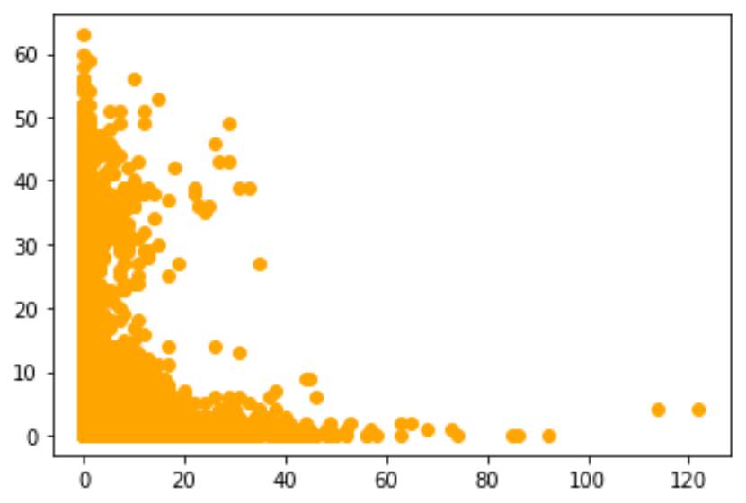
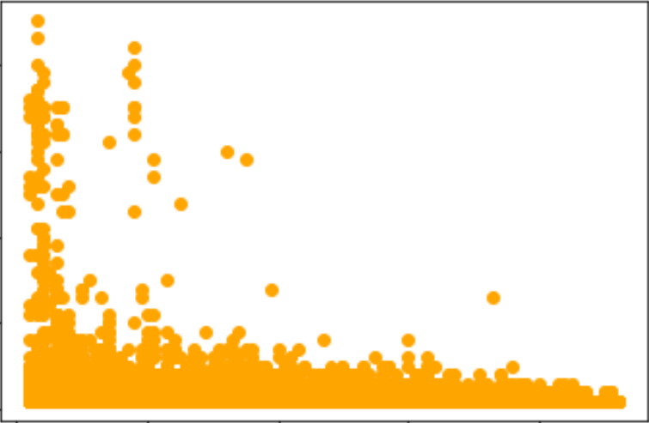
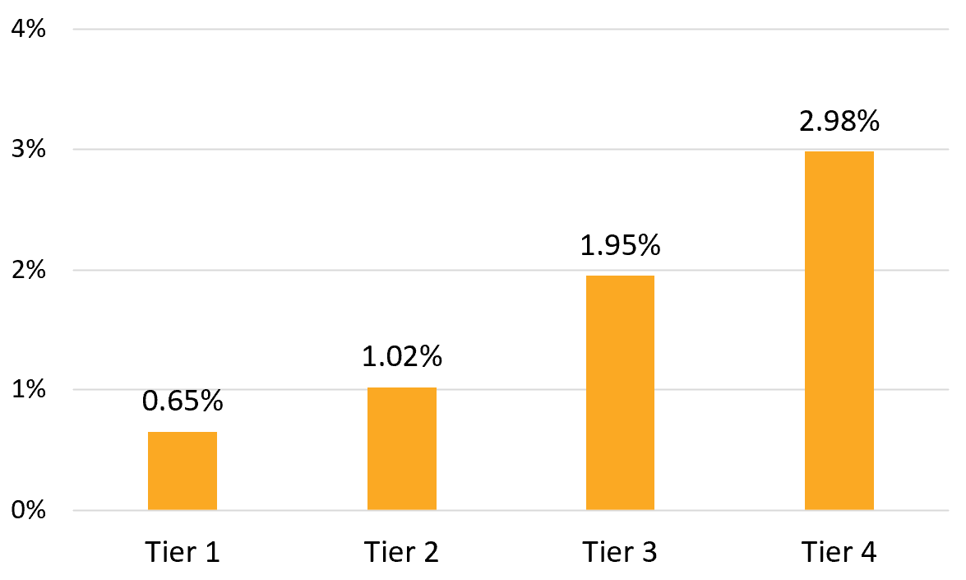
Inferences from Visuals
Graphing feature variables with target to get a sense of the directionality and strength of relationship and predicting power
Bar Chart: Click Rate by Member Tier
Scatterplot: Clicks vs Days Since Last Click
4%
40
2.98%
3%
30
1.95%
2%
Clicks
20
1.02%
1%
0.65%
20
0%
0
Tier 1
Tier 2
Tier 3
Tier 4
0
30
60
90
nce Last Click

Slide 14
Feature Selection Using Decision Tree
Built simple (no fine-tuning) decision tree to used as guide for feature selection
Gain better idea of what variables are of importance
Reveal highly correlated variables to identify reduction opportunities
Glimpse into what the predicting power of the already-built variables

Slide 15









Variables of Importance
Total Clicks
Business/Leisure Code 2 Stays
Campaign Type
Member Tier
Days Since Most Recent Click
Days Since Most Recent Check-In
Click Rate
Member Program Tenure
Note: Variables are in order of importance to the decision tree model. Only variables with importance coefficients of 0.10 or above are listed.

Slide 16
Next Steps
Test ways to handle click imbalance
Continue variable selection methods
Begin classification model tuning and evaluation
Model campaign types separately

Slide 17
Deliverables

Slide 18
Recommendation of Best Model
A final decision tree and Naïve Bayes model will be compared using performance metrics that show ability to reduce erroneous predictions
The best predictive model will be our recommendation
Notes:
ROC is an area under the curve measure that tells us how much the models are capable of distinguishing between a click or no click.
And error and sucess measures such as precision, recall and accuracy

Slide 19
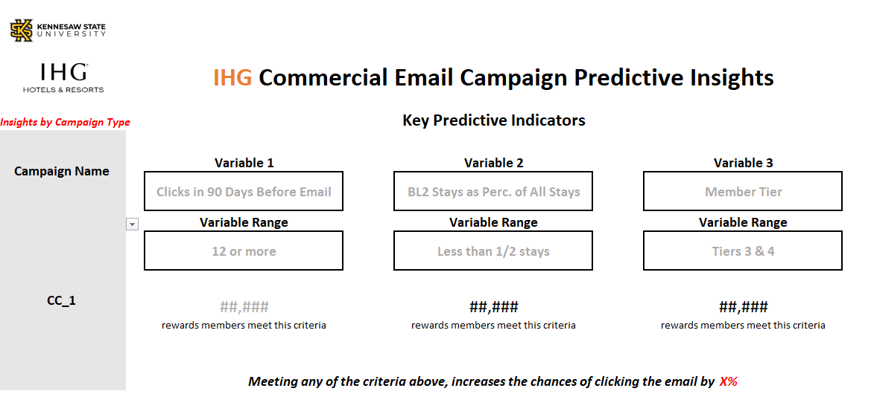
Interactive Dashboard

Slide 20
Thank you! Questions?

Slide 21
Appendix

Slide 22
Appendix Table of Contents
Original Feature Engineering Plan
Why a Decision Tree?
Tree Variations and Comparison
Model Performance for Best Decision Tree for Feature Selection
Assumptions Made about Click Definitions
To add before March 16 presentation to IHG:
Example View of First 3-4 Levels of Decision Tree

Slide 23
Why Decision Trees?
Interpretability - perhaps more important than predicting a click for each email sent, IHG would benefit from reward member segmentation insights
Manages the missing stay history variables well

Slide 24


Tree Variations and Comparison
Binary tree (max 2 splits)
ROC Index: 0.76
3-way tree (max 3 splits)
ROC Index: 0.87
3-way tree + Email Send Date
ROC Index: 0.87

Slide 25
First Draft Tree Model Performance
The best performing tree model’s Confusion Error) matrix is shown below
Tree utilized our first pass variables
Precision: 82.4%
Recall or True Positive Rate: 10.4%
 | Actuals
Predicted | Positive (Click, 1) | Negative (No Click, 0)
Positive (Click, 1) | TP = 28 (0.19%) | FP = 6 (0.04%)
Negative (No Click, 0) | FN = 242 (1.61%) | TN = 14,724 (98.16%)
Notes:
F1 score?

Slide 26
Understanding of the Data
If an email marketing link was clicked (CLICK = 1),
Then a member clicked on either an
Offer page or Non-offer page
Unsubscribed
If an email marketing link was not clicked (CLICK = 0),
Then the email may have been opened, but no way to confirm
Cancelled stays are not included in the stay history dataset
All confirmation dates have a check-in and check-out date
Notes:
MK-1.5 Minutes

Slide 27
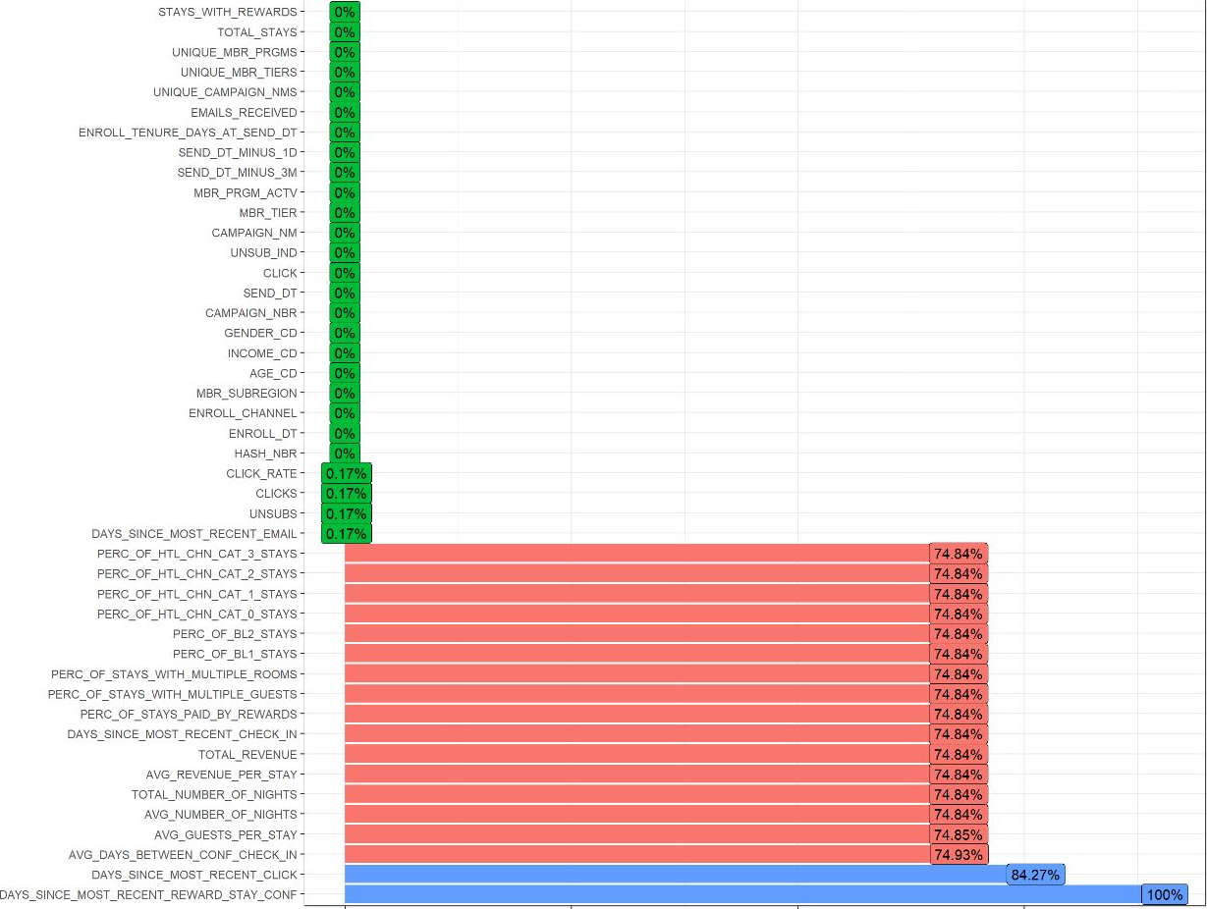
Percent of Rows Missing a Value by Variable

Slide 28
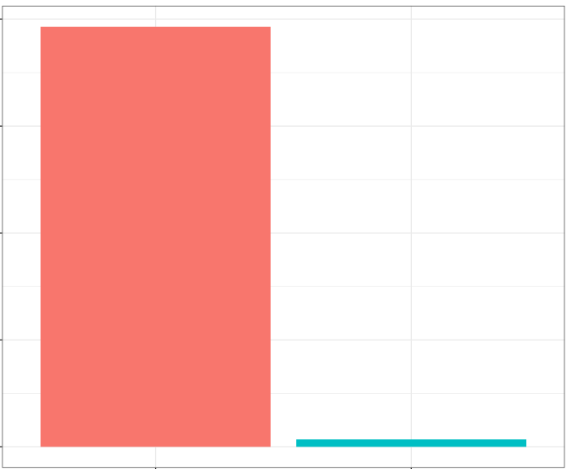
Percent of Click/No Click in the 1-month Dataset
100%
75%
50%
25%
98.2%
1.76%
0%
No Click
Click

Slide 29
Original Feature Engineering Plan
Member Variables
Email Variables
Stay Variables
Enroll Channel
Total Clicks
Days Since Last Holiday
Total Unique Stays
Weeks Since Last Stay
Most Recent Member Tier
Proportion of Clicks by Campaign Type
Days Until Next Holiday
Average Nights per Stay
Proportion of Stays by Purpose
Most Recent Member Lifecycle
Click Rate by Member
Indicator for Recent Change in Membership Tier
Total Revenue
Weeks Since Last Booking
Age Group
Membership Tenure on Email Send Date
Seasonal Indicator
Average Revenue per Stay
Average Days Between Conf. and Check-In
Income Group
Days Since Last Click
Weekday Indicator
Total Number of Nights Stayed
Proportion of Stays by Hotel Chain Category
Gender
Days Since Last Email
Total Emails Received
Average Guest Quantity per Stay
Proportion of Stays Paid by Points/Rewards
Weeks in Current Tier
Weeks in Current Lifecycle
Weeks Since Last Points/Rewards Stay
Proportion of Stays with more than 1 Guest
Note: Slide to be used as reference to initial variable list. More variables have been created since.

